Slide 1
Effective Communication

Slide 2
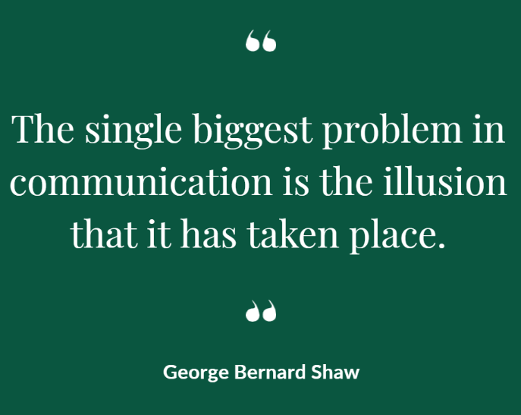

Slide 3
com·mu·ni·ca·tion \ kə-ˌmyü-nə-ˈkā-shən \ : a process by which information is exchanged between individuals through a common system of symbols, signs, or behavior.

Slide 4
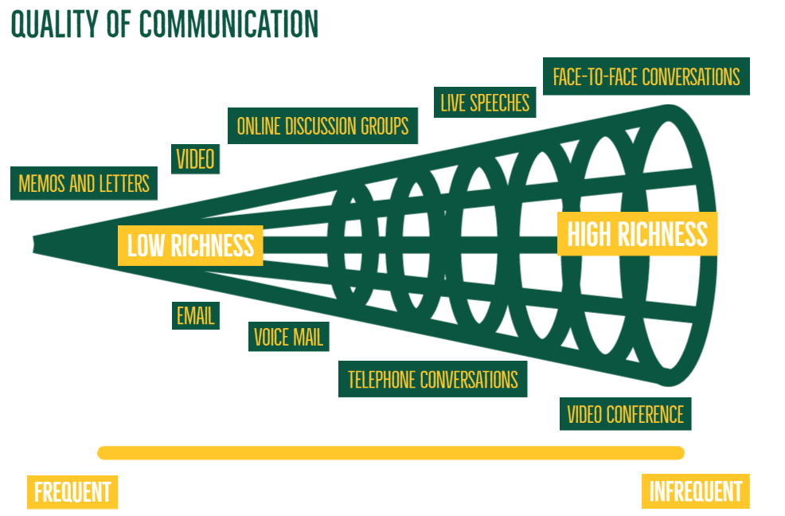

Slide 5
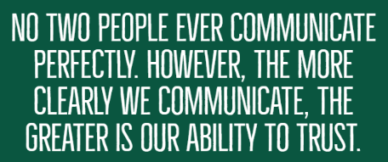
Why?
Effective communication helps us better understand a person or situation and enables us to resolve differences and build trust and respect.

Slide 6
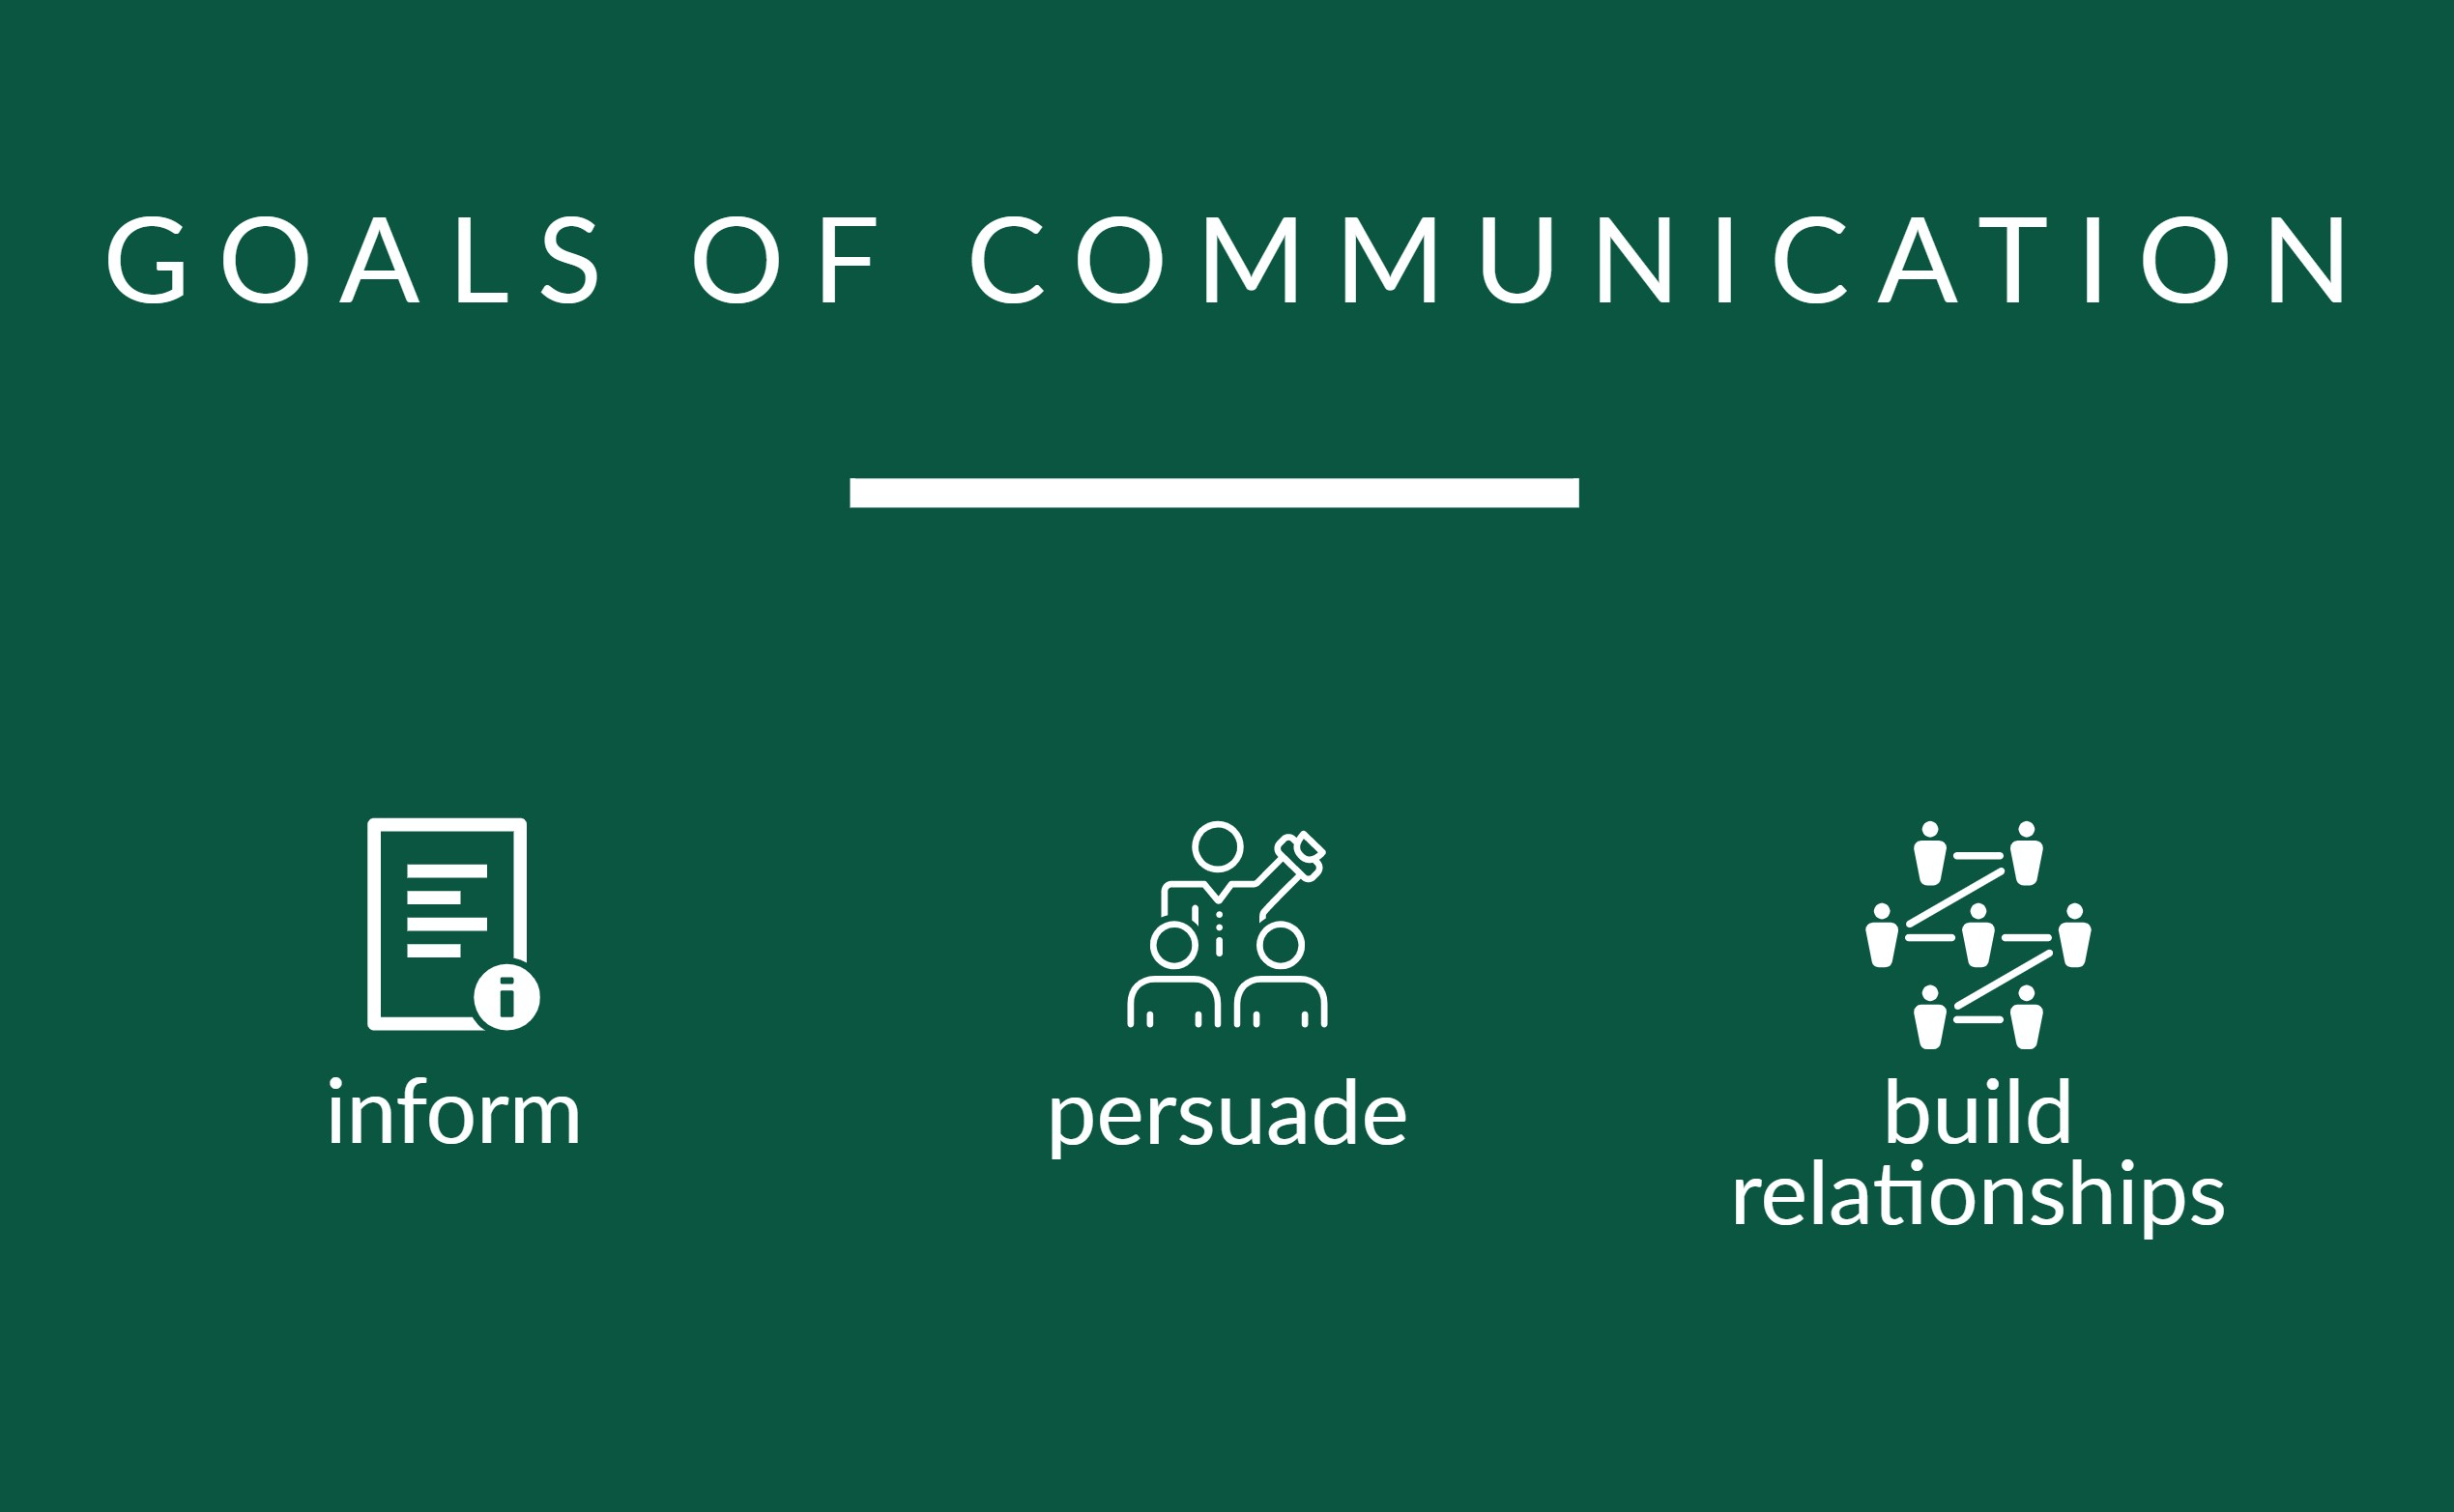

Slide 7
Why Effective Communication?
The ability to effectively communicate with others is one of the most important tools for professional and personal success.
Effective communication can help you influence others.
Your capacity to communicate is often seen as an indicator of your ability and intelligence.

Slide 8
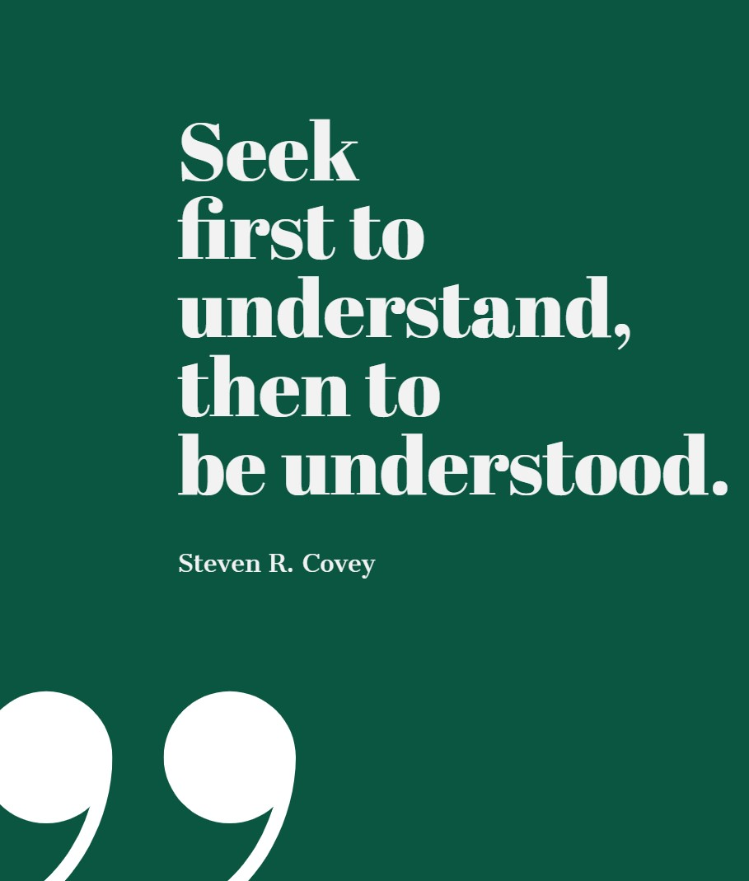

Slide 9
80% of workplace issues are communication related.

Slide 10
Elements of Personal Communication
Notes:
Dr. Albert Mehrabian’s 7-38-55% Rule
7% of the message is conveyed through word choices. 38% of the message is conveyed through voice tone. 55% of the message is conveyed through body language. Only 7% of your message is through words! Think about how much your tone and body language is communicating. Think about talking on the phone – main communication is through your tone. Your tone is going to make or break the conversation.
Please remember that this formula is not intended to be applied across all communication. Different scenarios cause different results but it’s a good reminder on how important tone and body language is during a conversation/communication.
Do you smile when you talk on the phone? What is your tone in emails?

Slide 11
If words disagree with the tone of voice and nonverbal behavior, people tend to believe the tonality and nonverbal behavior.
Dr. Albert Mehrabian

Slide 12
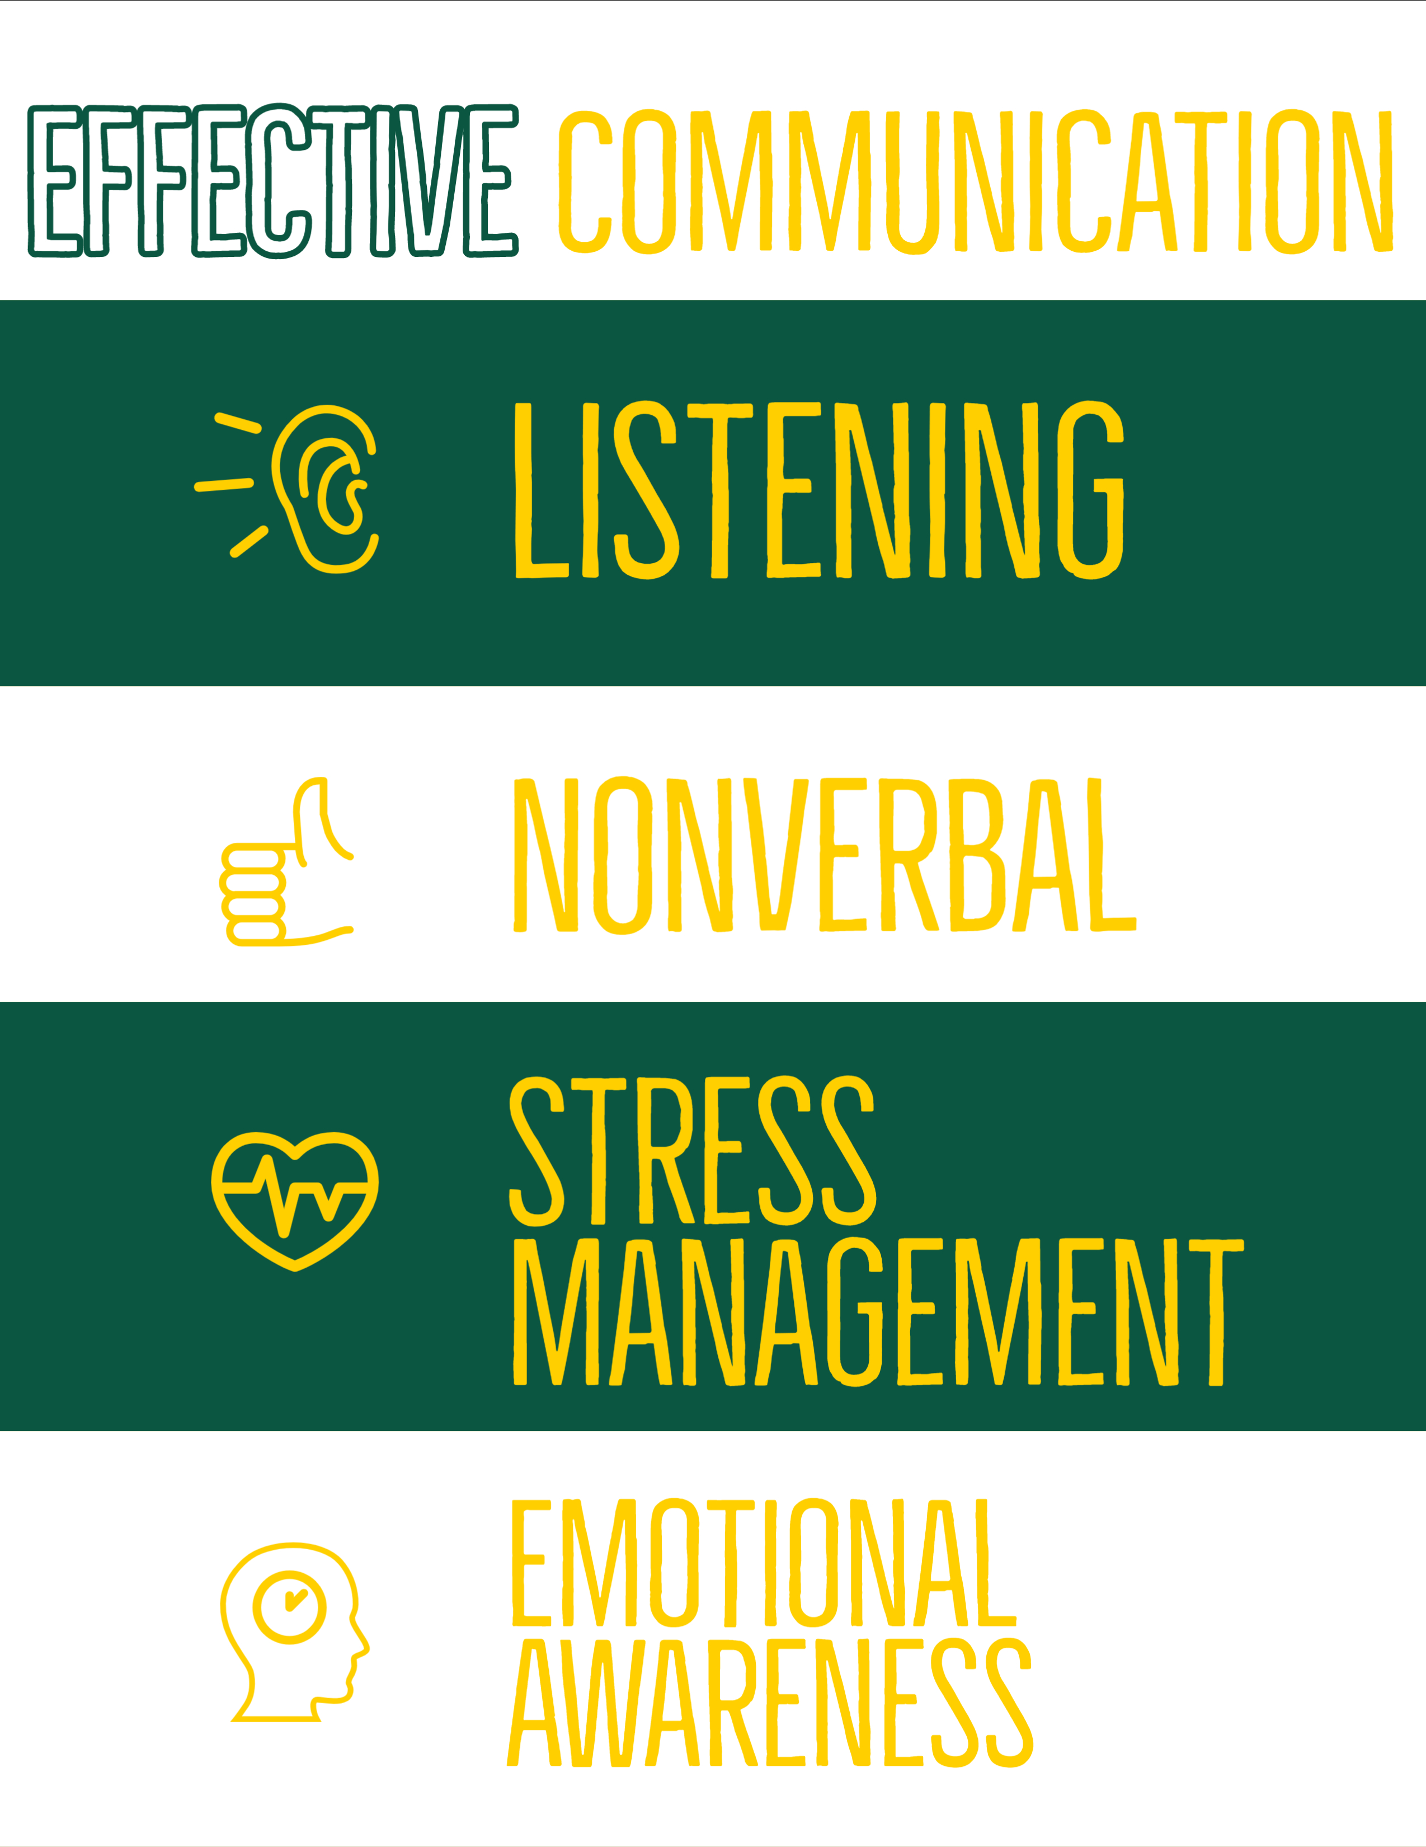
Notes:
Effective communication combines a set of skills including attentive listening, nonverbal communication, the ability to manage stress in the moment, and the capacity to recognize and understand your own emotions and those of the person you are communicating with.
Remember – effective communication is a learned skill and it is more effective when it’s spontaneous. For example – a speech that is read rarely has the same impact as a speech that’s delivered spontaneously. It takes time and effort to develop these skills.

Slide 13
Listening

Slide 14
Active Listening
More than just hearing someone speak.
You fully concentrate on what is being said.
You listen with all your senses and give your full attention to the person speaking.

Slide 15
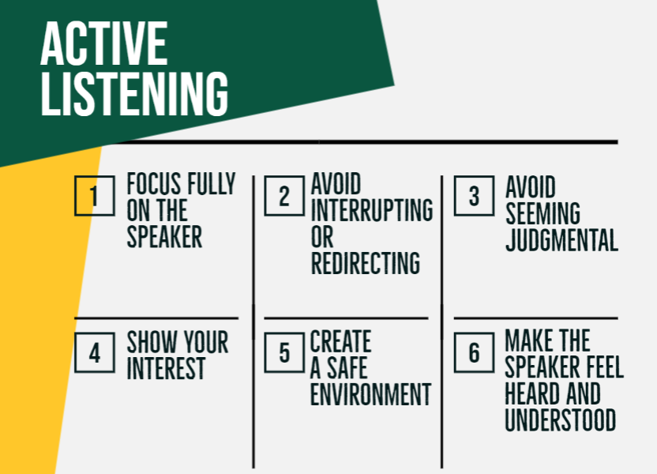

Slide 16
Are you an active listener?
Notes:
ACTIVITY (10 Minutes): Have printout of story too
Pretend that you are a bus driver. It is your job to drive the MAT Bus. One day you get on the bus and you start to count. At the first stop 5 people get on your bus. At the next stop 3 people get on and 2 people get off the bus. At the next stop 2 people get off the bus. At the next stop 3 people get on and 1 person gets off the bus. Here is the question. What color are the eyes of the bus driver?
Interesting stats:
When you first ask the question - Usually at this point less than 25 % of the group will know the answer.
Repeat the question. According to research by the authors: 87% of the people taking the test for the first time will not be able to correctly answer the question. The second time people are given the test immediately following the first test 50% will still not be able to answer correctly. The third time people are given the test on the same day immediately following the preceding test 20% will still not be able to answer correctly.)

Slide 17
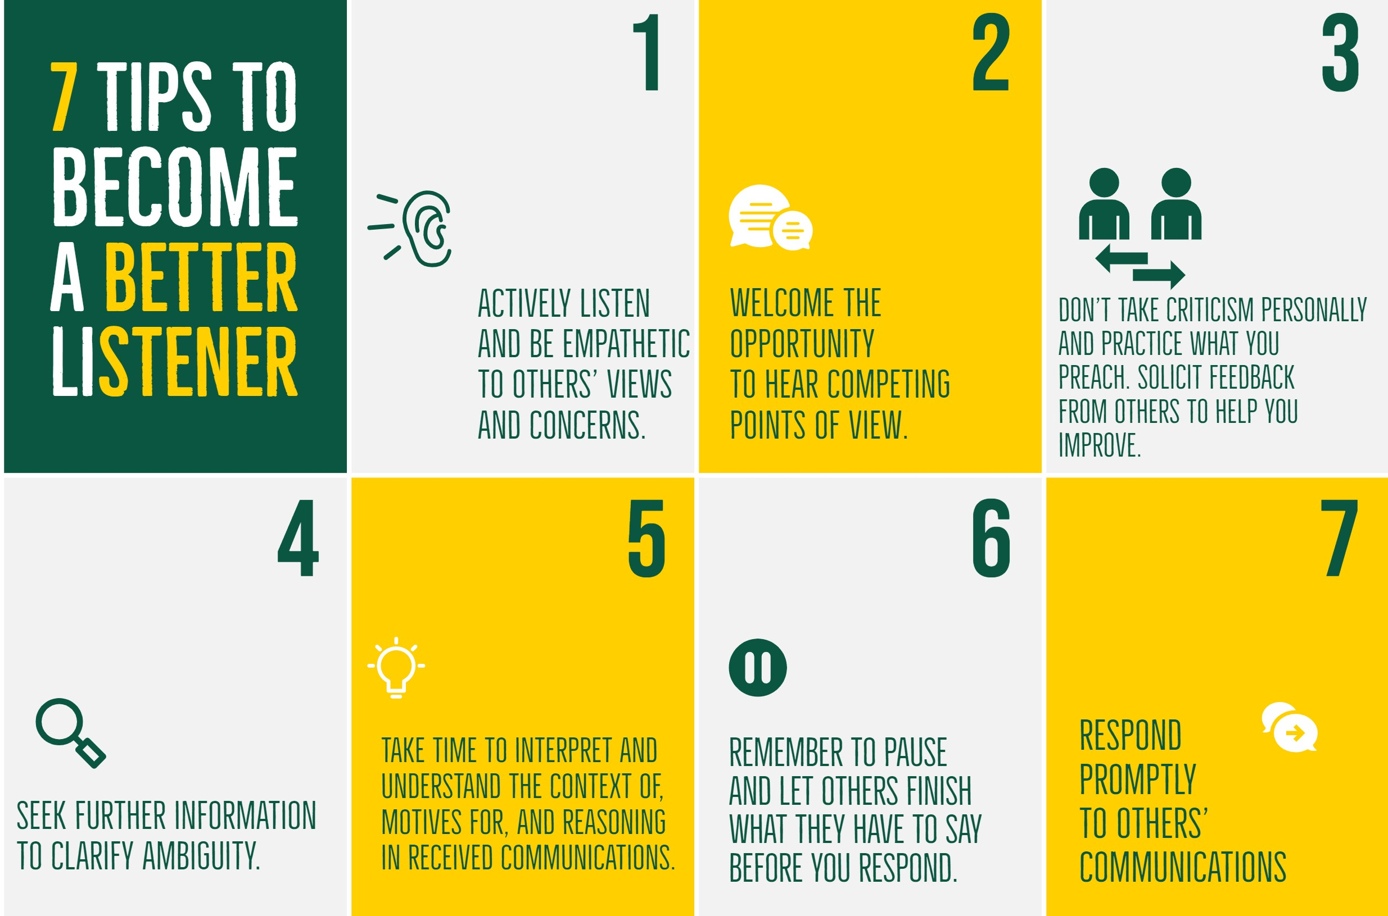

Slide 18
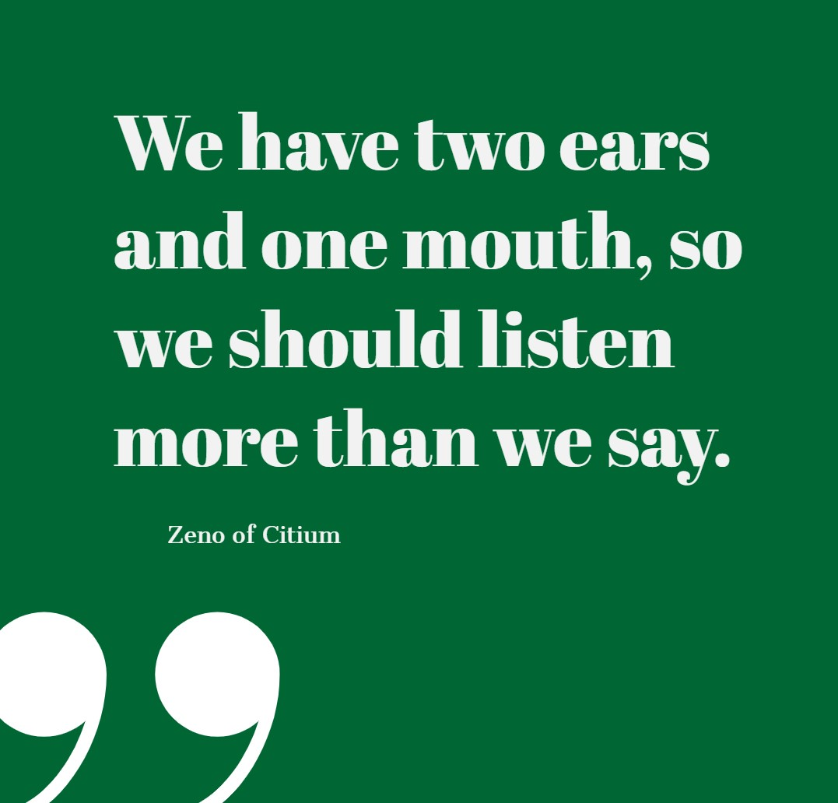

Slide 19
Nonverbal Communication

Slide 20
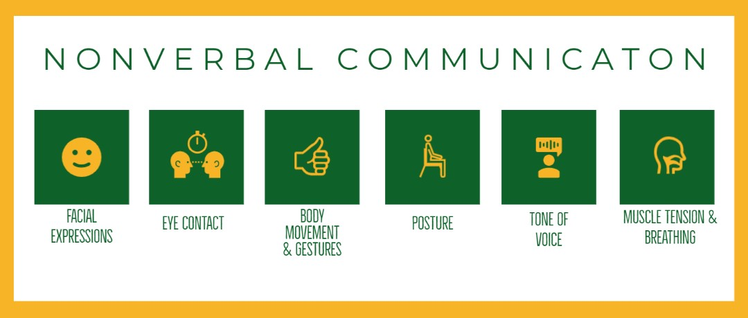
Notes:
Second skill in effective communication is recognizing and using nonverbal correctly – yourself and being able to read others.
Developing the ability to understand and use nonverbal communication can help you connect with others, express what you really mean, navigate challenging situations and build better relationships. If you are the receiver of a negative or stressful message, what is your face and body saying? What have you witnessed from others in that situation? Eye rolling, foot tapping, heavy sighing, eyebrow raising, crossing arms, hands on hips, shaking of a finger, etc.
Studies suggest that over 90% of the meaning we derive comes from nonverbal cues that one person gives to another.

Slide 21
Improve how you read nonverbals!
People watching
Be aware of individual differences
Look at nonverbal signals as a whole

Slide 22
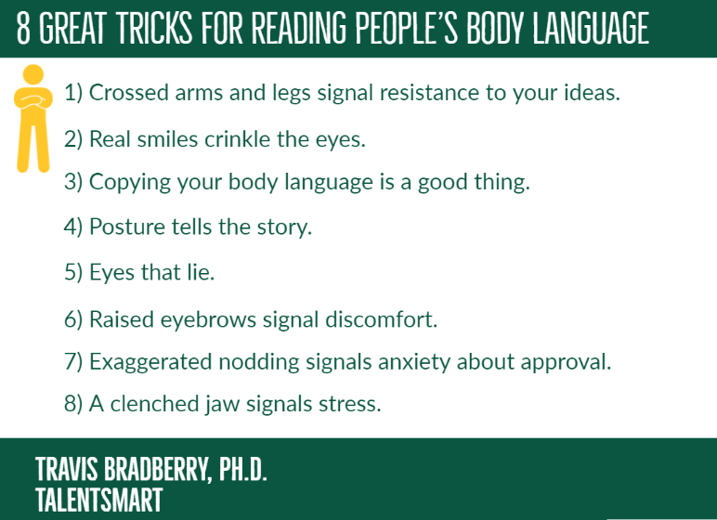

Slide 23
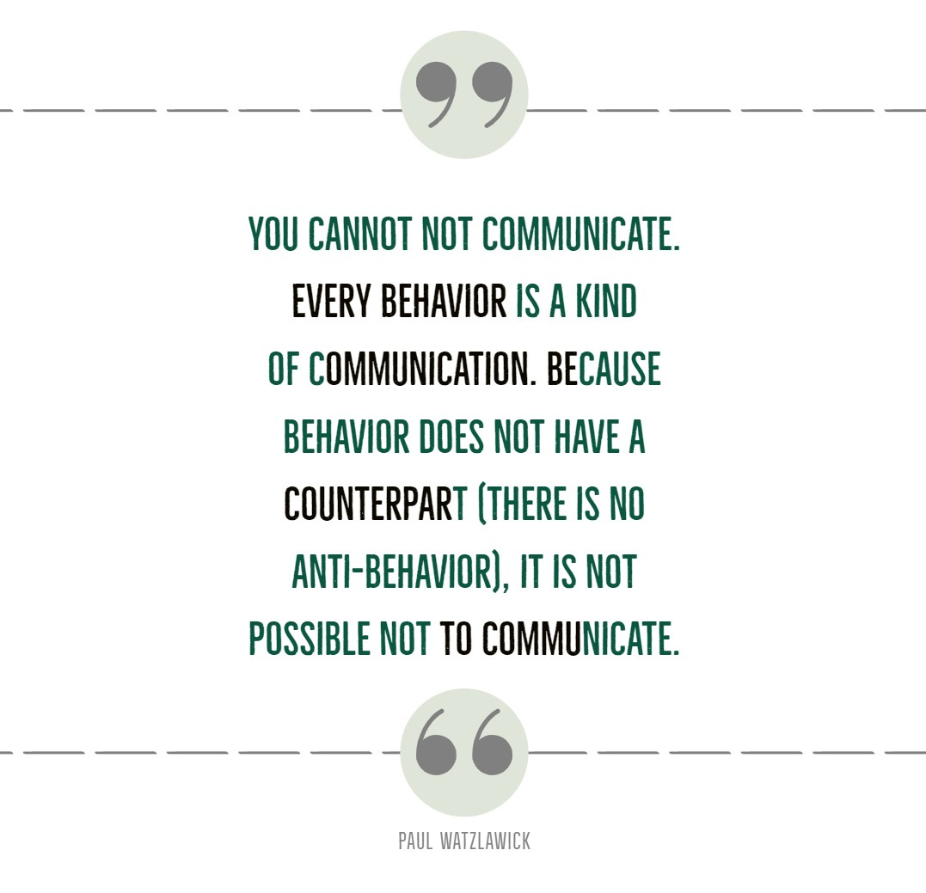

Slide 24
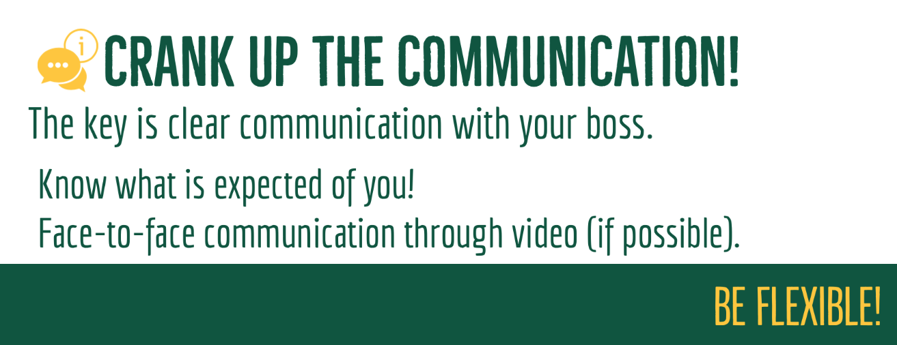

Slide 25
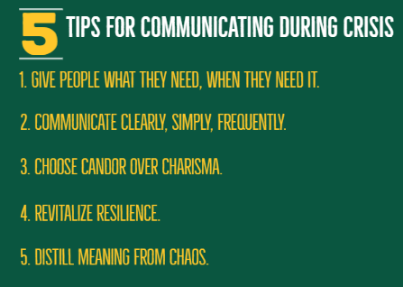

Slide 26
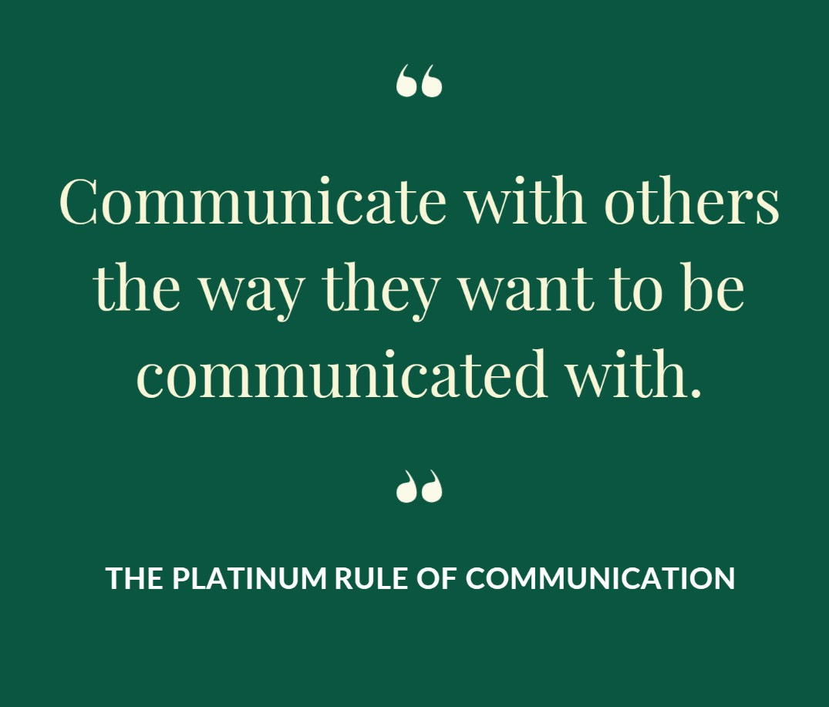

Slide 27
Resources
Behavioral Communication Style Evaluation
Based on the work of Tony Alessandra
8 Great Tricks For Reading People’s Body Language
Travis Bradberry, Ph.D., TALENTSMART

